Slide 1
Research Roundtable: Healthy Brain Network Dataset
Jessica Lammert
CBS Methods Lunch

Slide 2
Get these slides!

Slide 3
Part 1: Introduction to the Healthy Brain Network (HBN) Part 2: Applications of Machine Learning with the HBN
Notes:
Explain history: HBN is large open dataset
Allows for collaborative, interdisciplinary, work that requires large amount of data
Used subset for PhD study and also uploaded for others to use

Slide 4
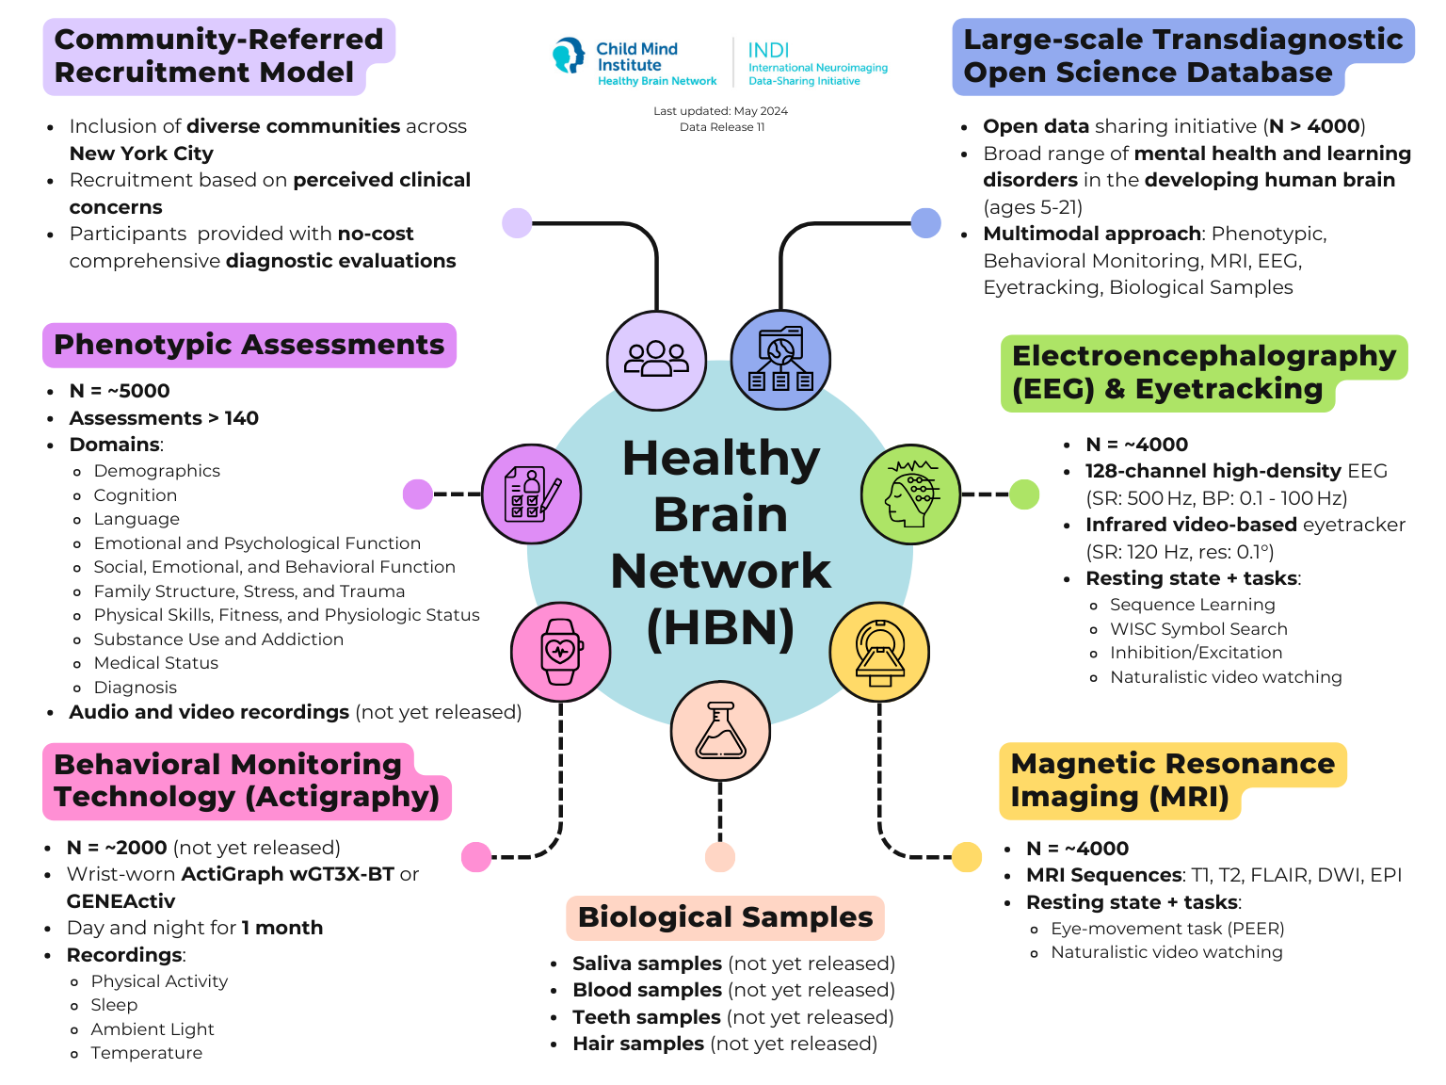

Slide 5

Healthy Brain Network Dataset
Clinically referred large-scale study
Community Website
Project Website
Alexander et al., 2017
MRI (N ~4,000)
T1w, FLAIR, T2w, DWI, resting-state, Despicable Me, The Present, Peer
EEG (N ~4,000)
Resting-state, WISC symbol search, sequence learning, inhibition/excitation, visual perception/decision-making, naturalistic viewing, The Present
*datasets are not guaranteed to be complete (neuro/pheno) or “good” quality
Notes:
DEMO
Changes to website, EEG BIDS now available, some releases taken down/reuploaded, recommend cyberduck
New MRI, install with datalad, associated with RBC, additional analyses?

Slide 6
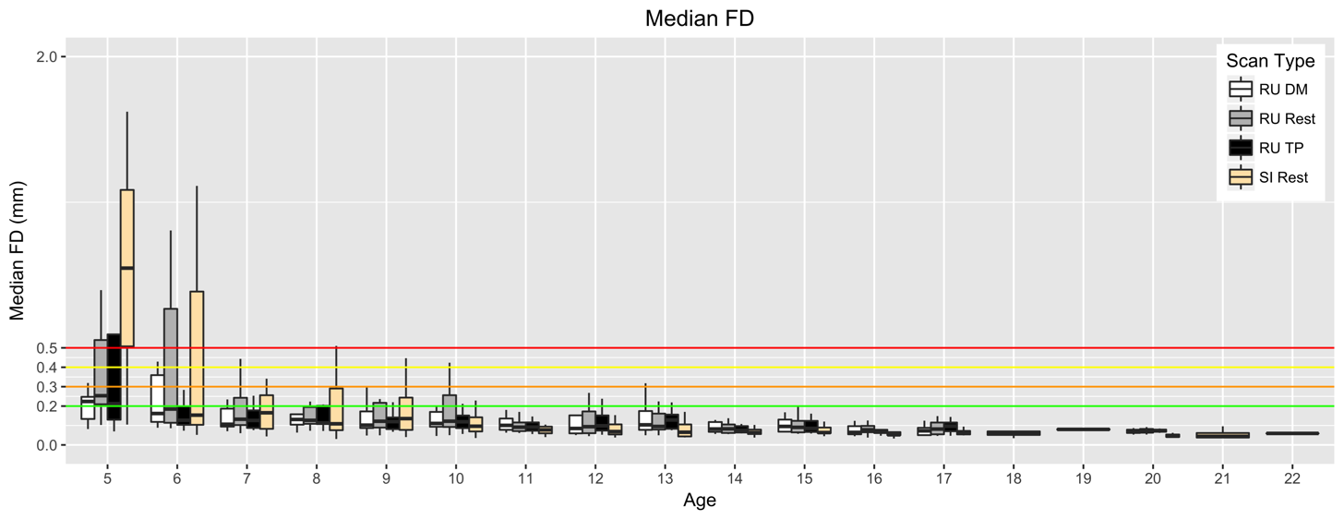
Motion

Slide 7
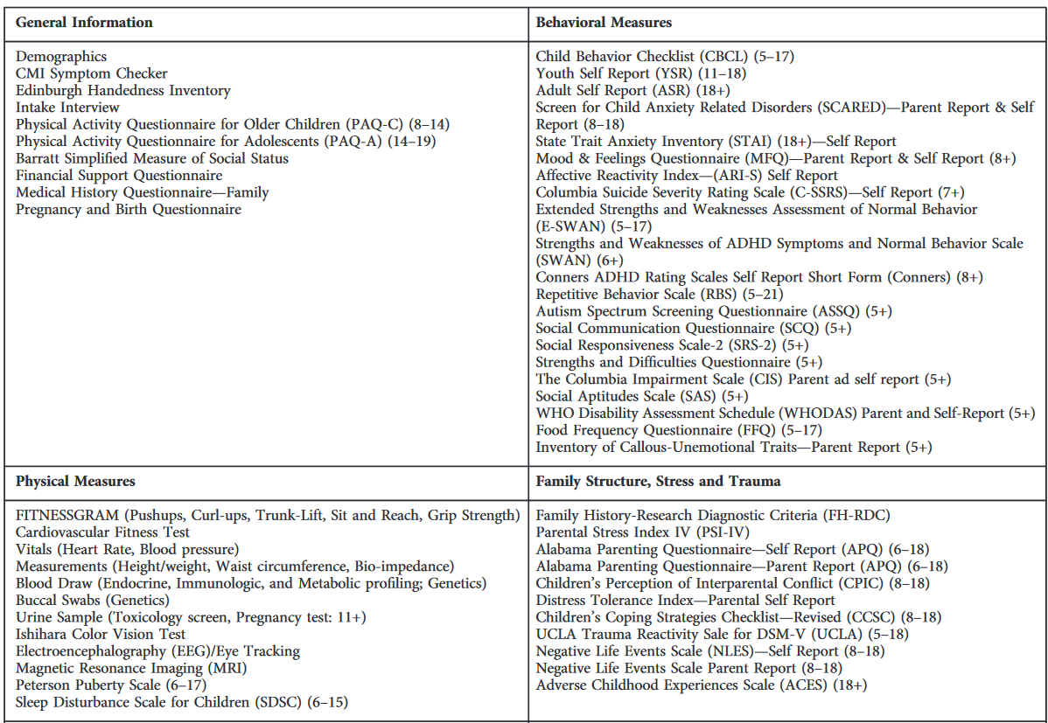
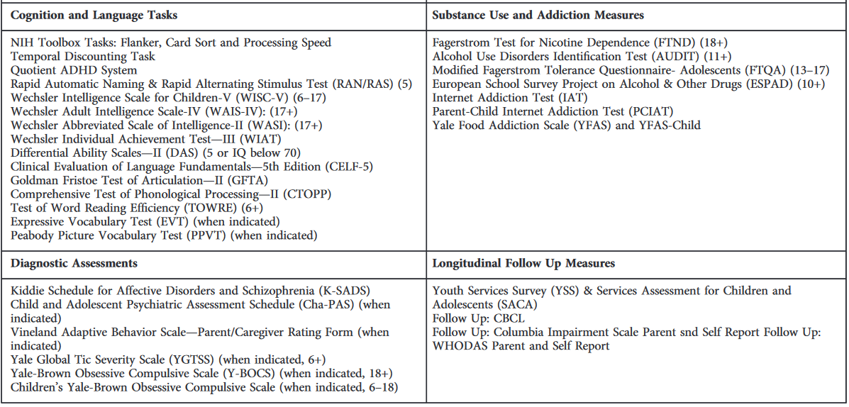
Phenotypic Assessments Phenotypic Assessment Protocol
Other data: Actigraphy, Narrative Retelling

Slide 8
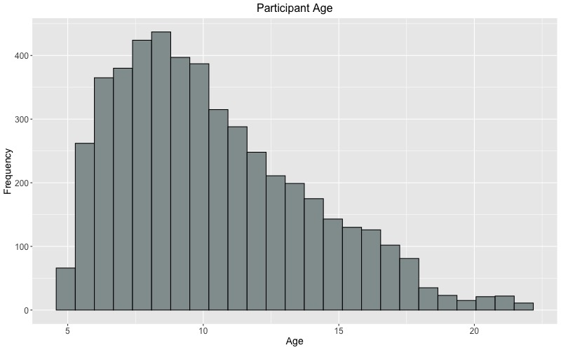
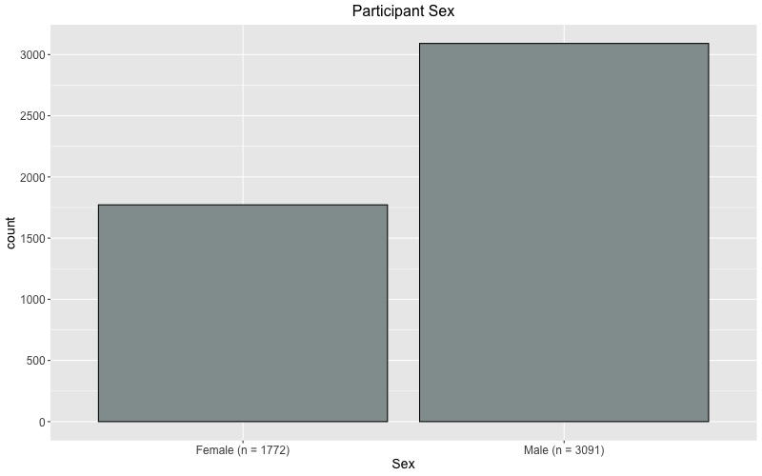
Age and Sex distribution (N = 4,863)

Slide 9
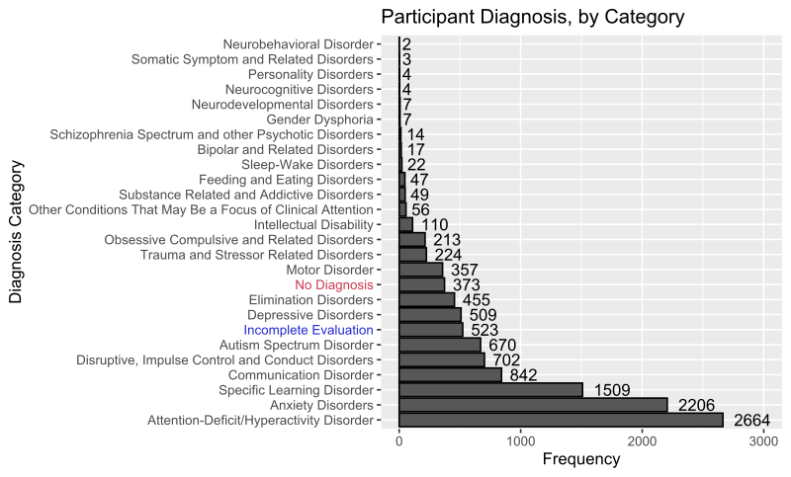
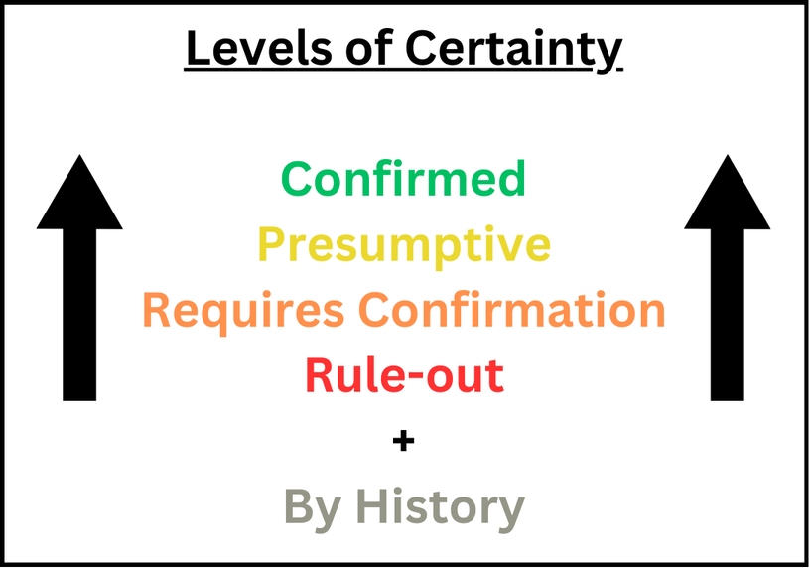

Slide 10
*NOTE
Principal Investigators must sign a Data Usage Agreement (DUA) with the CMI to access phenotypic data only (see example)
Phenotypic data is accessed through LORIS: https://data.healthybrainnetwork.org/main.php
Assessment list and data dictionaries are available on CBS server

Slide 11
HBN on the CBS server
Raw and pre-processed MRI and EEG data are available
Users can store processed data, scripts, etc. or call to the drive from other directories
25 TB
Store data outputs (e.g., .csv files; on personal drive)
Shared drive: keep original files intact, tag folders with your initials
Notes:
Use CBS server to run demanding processes
May transfer to Compute Canada which is capable scheduling and more demanding tasks

Slide 12
Request access to the open_data_hbn project on Schulich HelpDesk: s https://westernu.atlassian.net/servicedesk/customer/portal/18 Network Services > Network Folder Access Request
Notes:
DEMO DATA ON SERVER – IF ANYONE HAS ACCESS FOLLOW ALONG

Slide 13
Pre-processed Data
MRI
fMRIprep 23.0.1 run on DRAC Graham cluster
skull-stripping, brain tissue segmentation, alignment, etc.
Output space: MNI152 non-linear asymmetrical, 2mm resolution
Out of ~1,500 selected datasets, ~1,000 were successfully pre-processed
~500 met manual QC criteria (1/3)
EEG and remaining MRI pre-processing ETA Summer 2025
MRI: N ~2,500 remaining, 1/3 acceptable quality = ~1,300 participants
Notes:
DEMO FMRIPREP OUTPUT

Slide 14
Links (Part 1)
HBN Community website
https://healthybrainnetwork.org/
HBN Project website
https://fcon_1000.projects.nitrc.org/indi/cmi_healthy_brain_network/
HBN data publication
https://www.nature.com/articles/sdata2017181
HBN phenotypic protocol
https://fcon_1000.projects.nitrc.org/indi/cmi_healthy_brain_network/Pheno_Protocol.html
DUA example
LORIS
https://data.healthybrainnetwork.org/main.php
Schulich HelpDesk
https://westernu.atlassian.net/servicedesk/customer/portal/18
Post-processing script
https://github.com/tkkuehn/hbn_postprocessing

Slide 15
Contact:
E-mail: jlammert@uwo.ca
Slack: westernbrainandmind.slack.com > #healthy-brain-network

Slide 16
Part 2:
Analysis & Feedback

Slide 17
“Big data” and Predictive Modeling
Want to model the relationship between multiple variables (often biological and behavioural)
E.g., What is the relationship between IQ and activity in PFC?
Data-driven: supervised or unsupervised learning
Categorization, classification, regression, etc.

Slide 18
Overview
Background: Narrative (story) comprehension is a multimodal process, important for learning and communication in childhood
Research Question: How do socio-cognitive skills support narrative comprehension in children?
Approach:
Multiple socio-cognitive tests
fMRI during movie-watching
Cluster participants into “narrative comprehension profiles”
Predict (classify) profile using socio-cognitive test scores

Slide 19
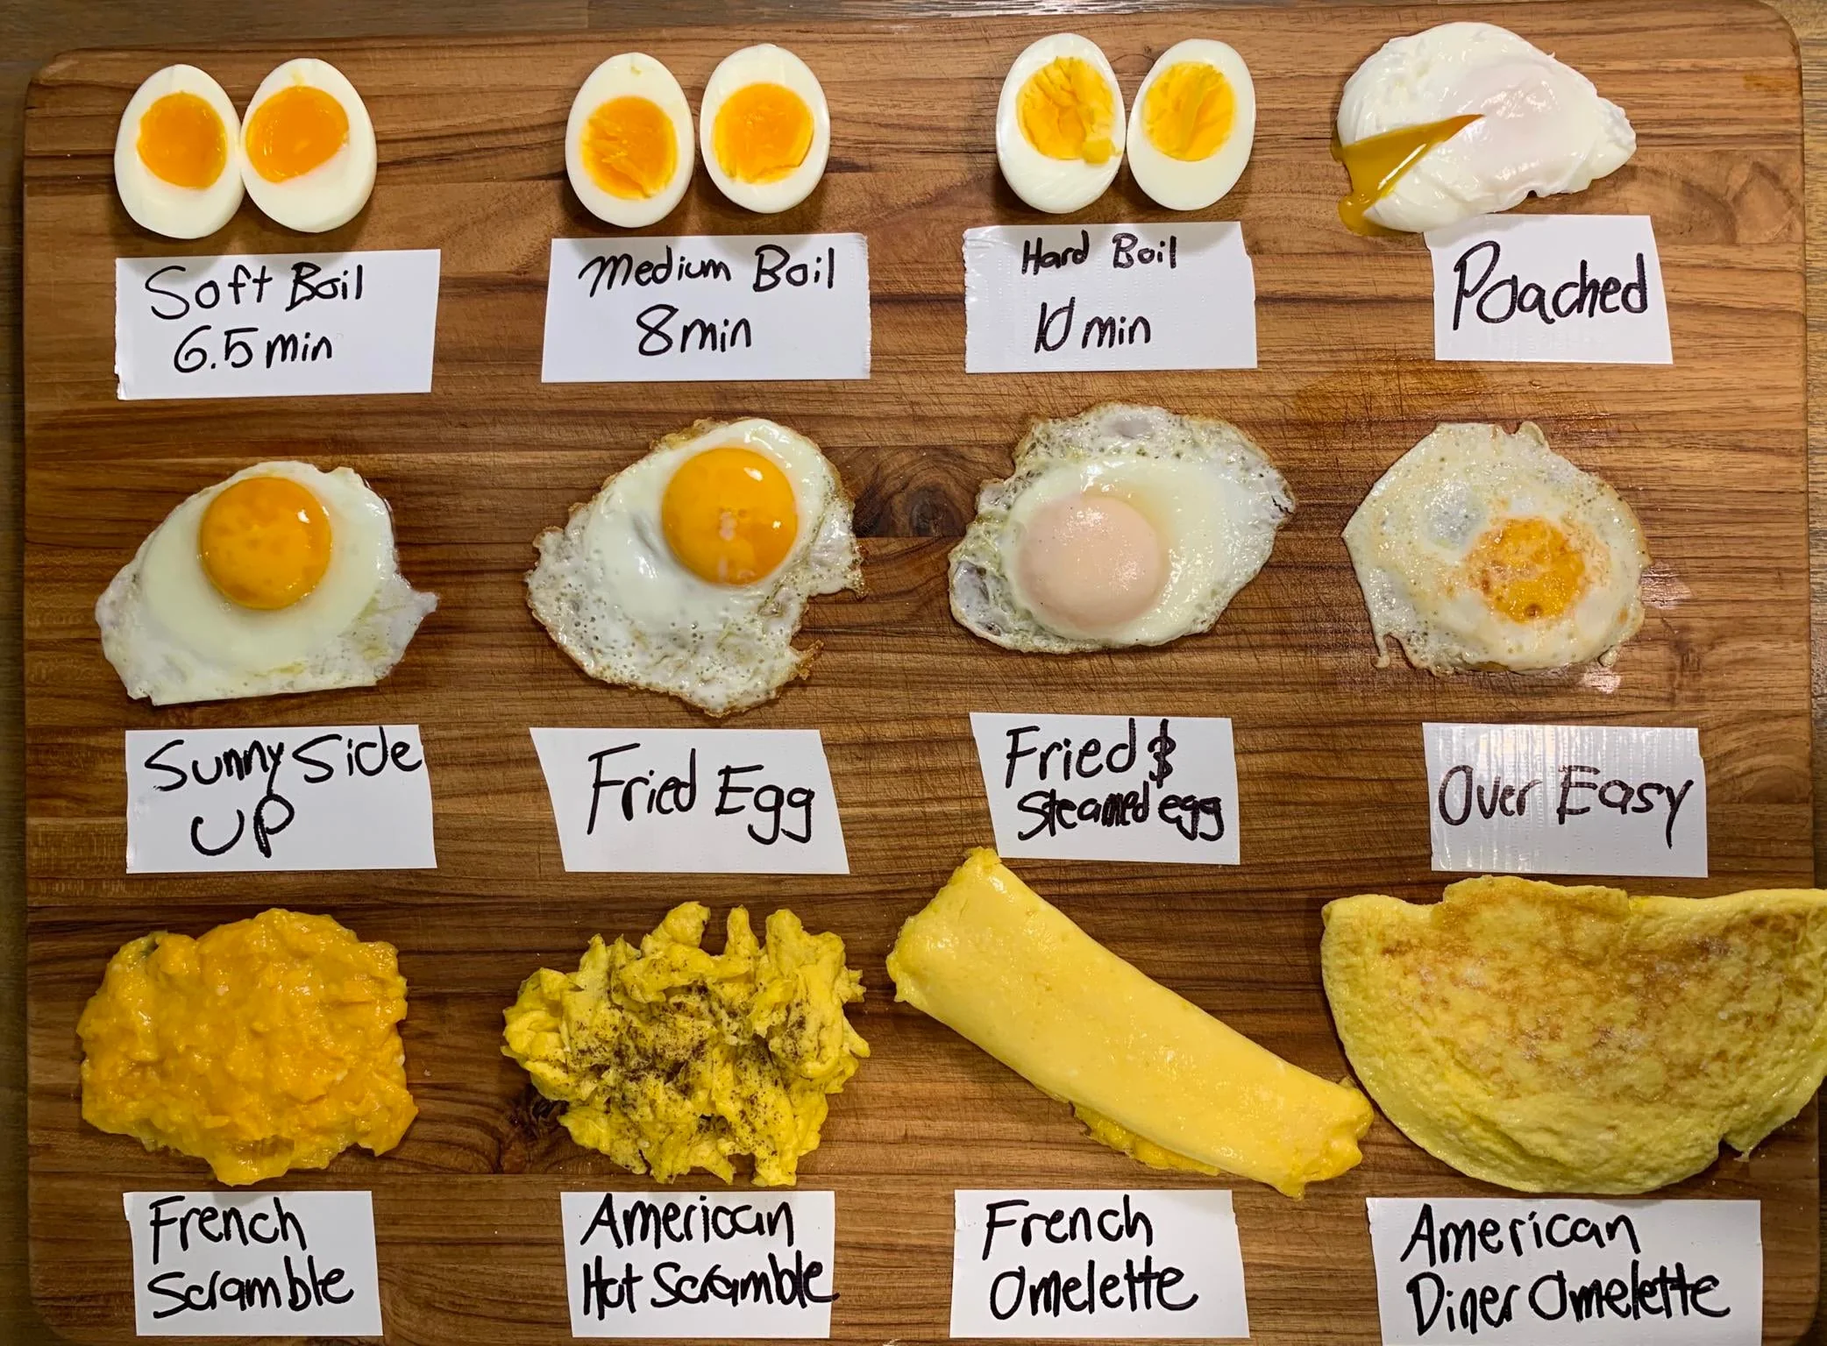
Question:
Are there more ways to cook an egg or analyze neuroimaging data?
A. Cook an egg
B. Analyze data
C. The limit does not exist

Slide 20
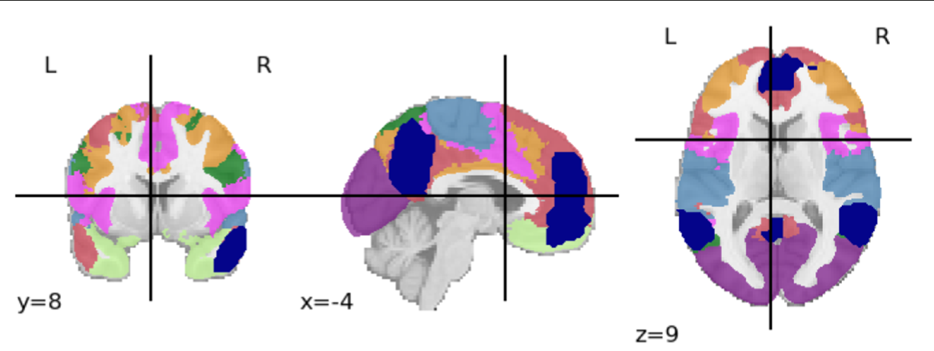
Brain Networks
Index | Network Name
1 | Visual
2 | Somatomotor
3 | Dorsal Attention
4 | Ventral Attention
5 | Limbic
6 | Frontoparietal
7 | Default-mode
8 | Theory of Mind

Slide 21

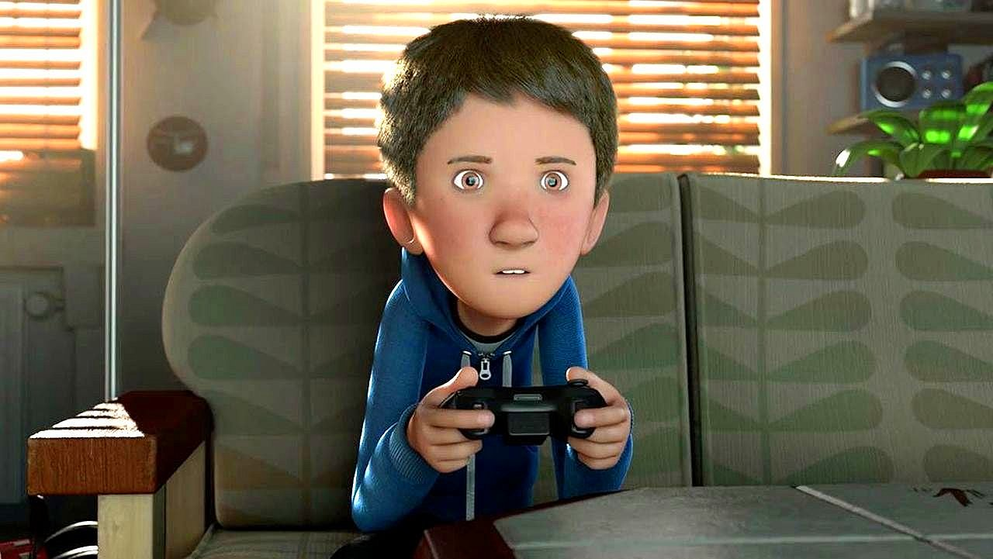
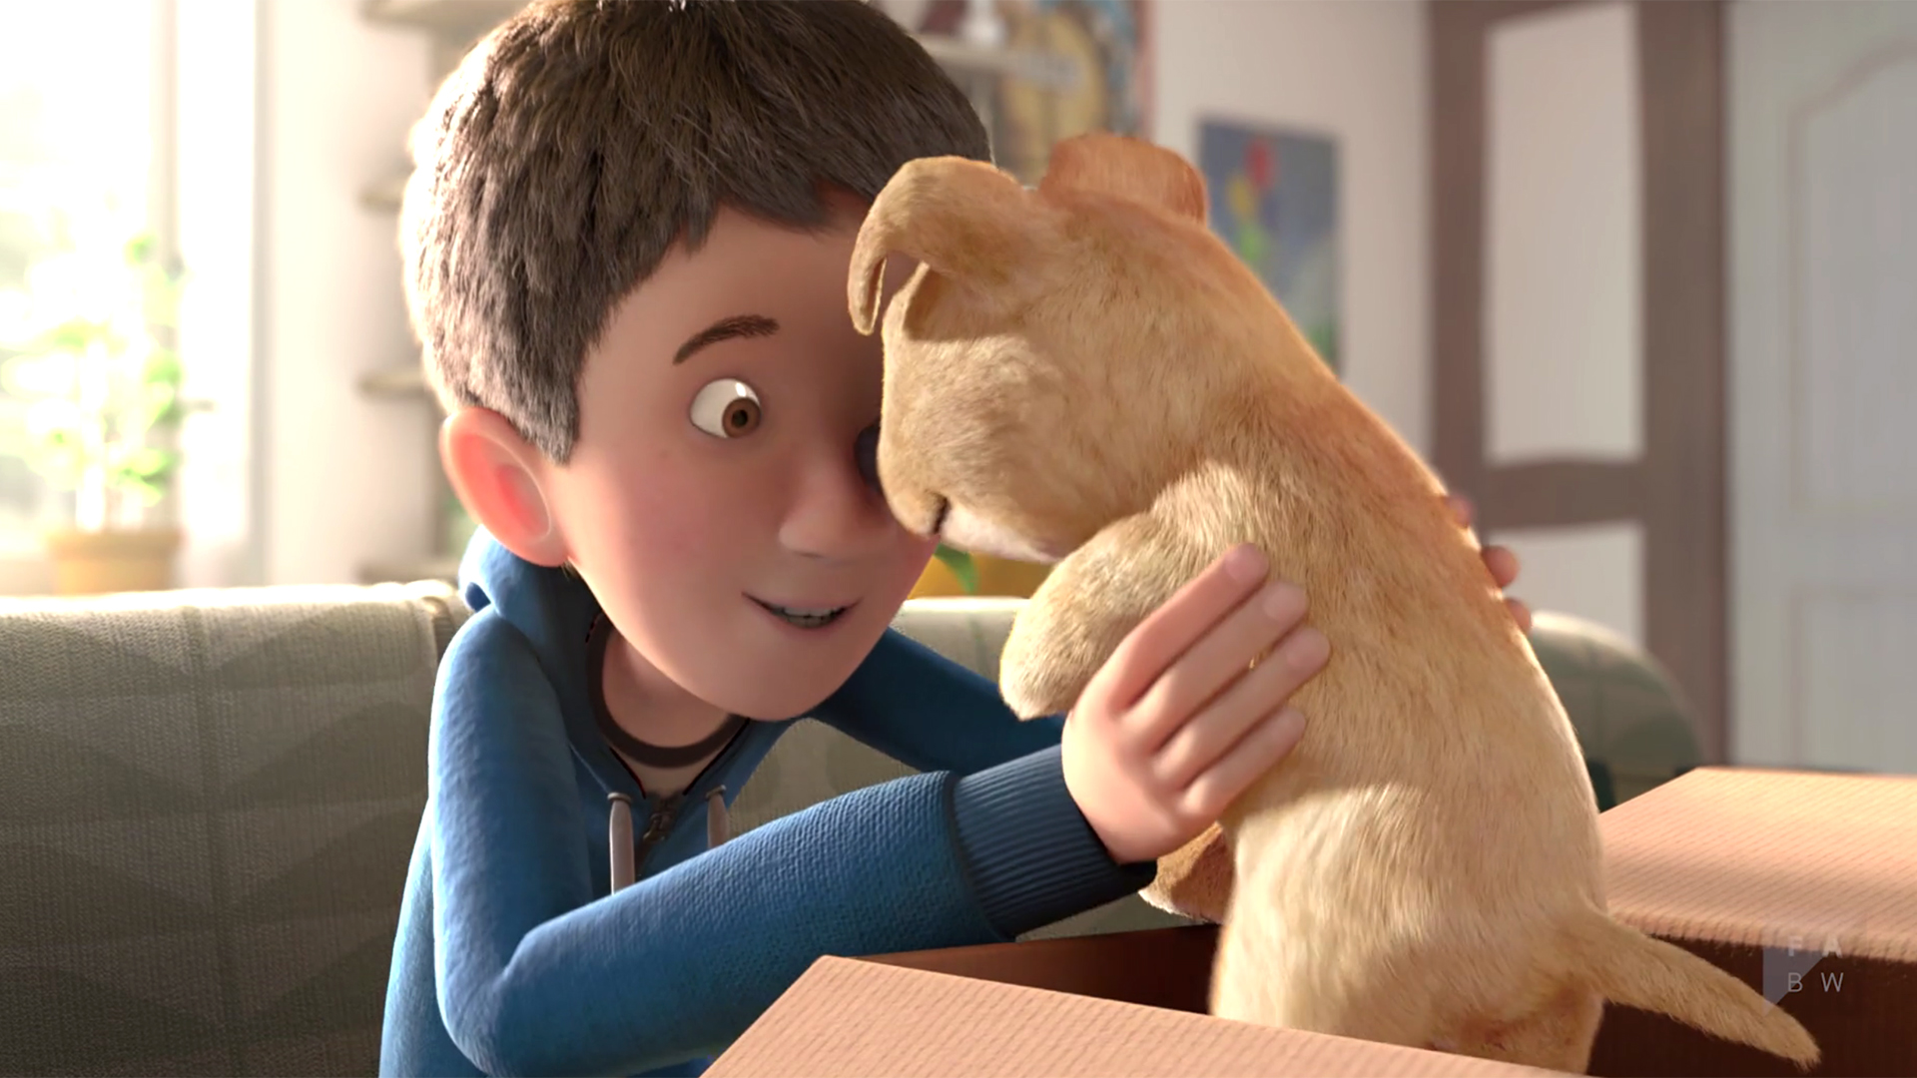
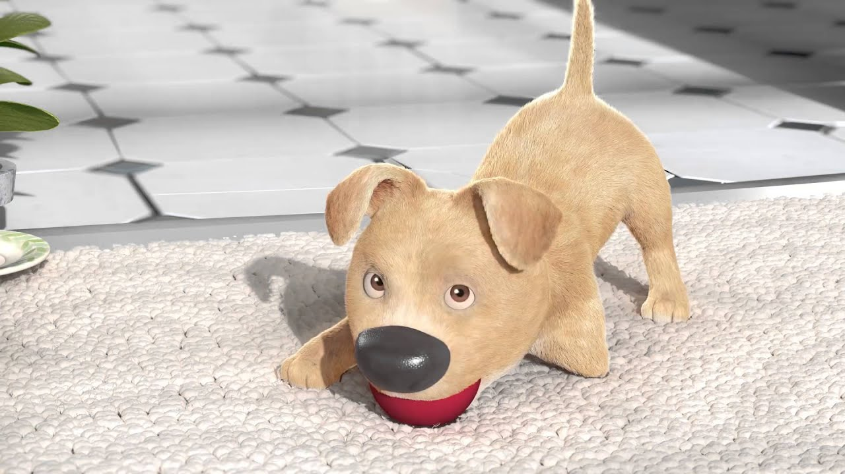
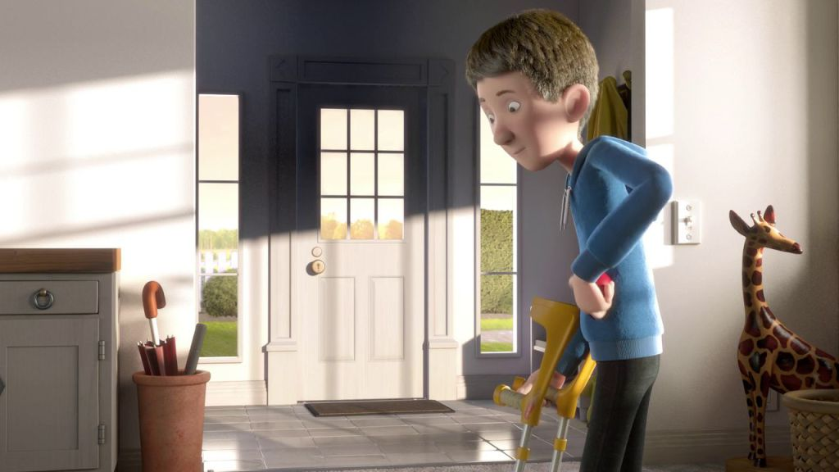
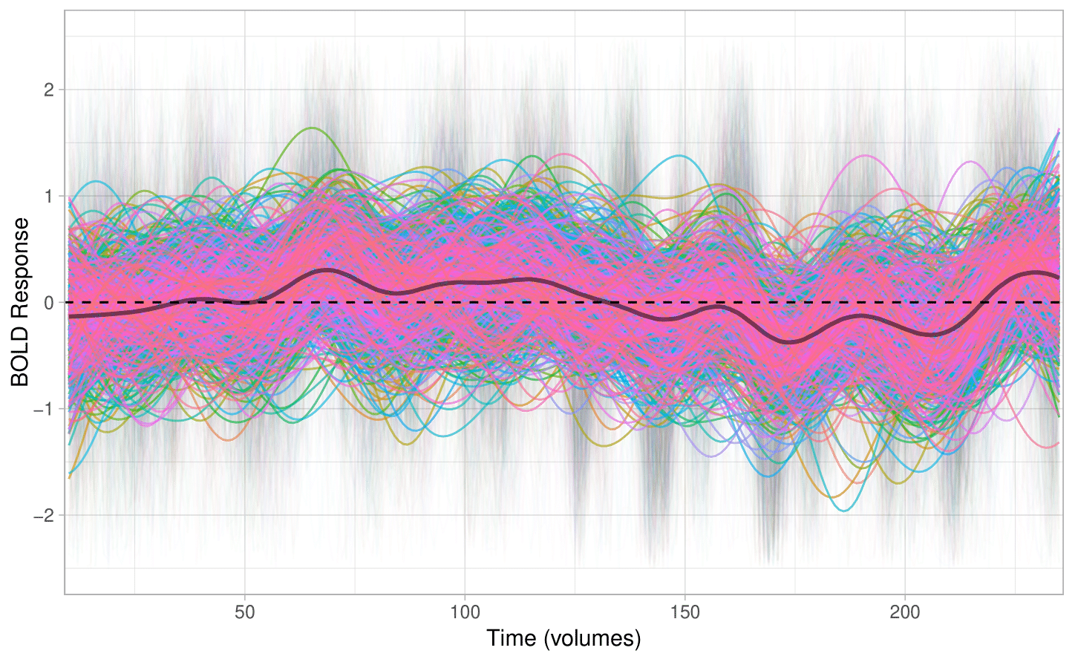
BOLD activation to The Present in the Dorsal Attention network
N = 526
Age 7-17

Slide 22
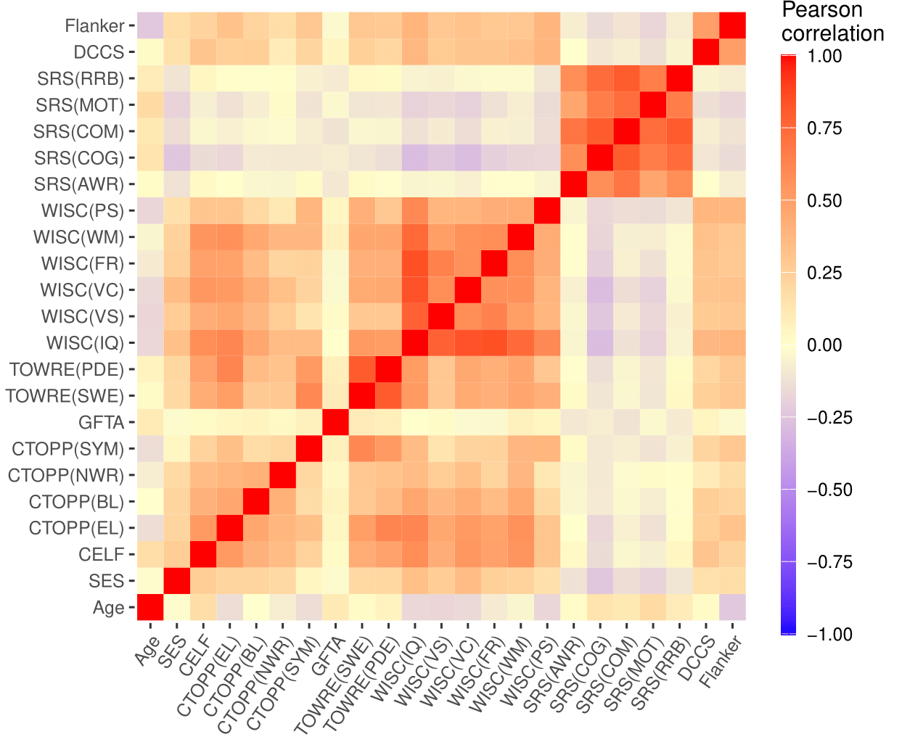
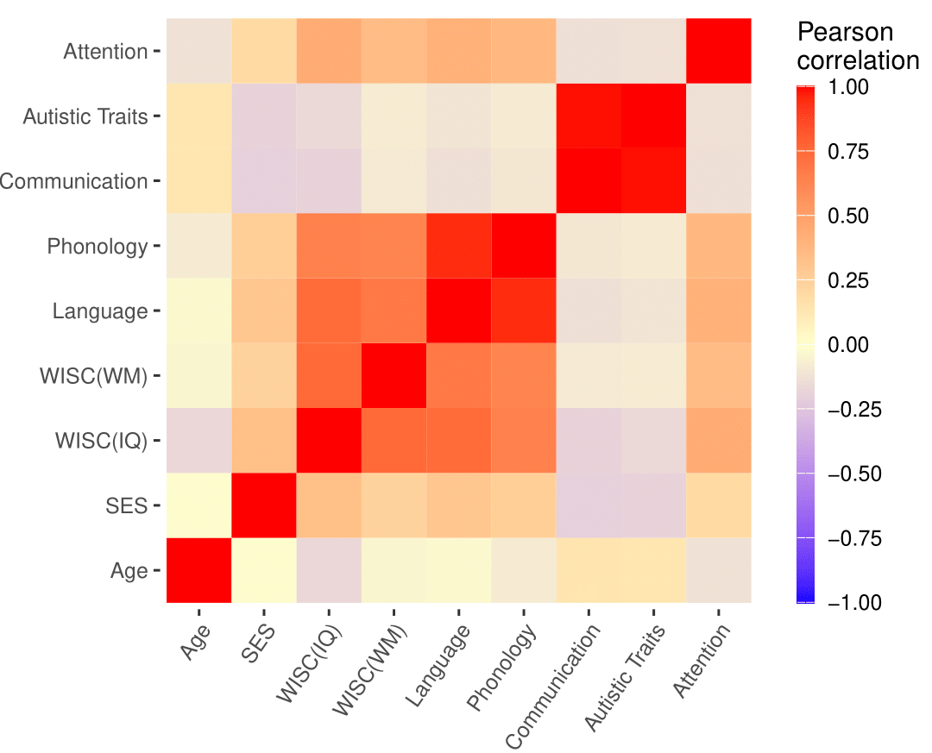
Phenotypic Measures
Composite Variables

Slide 23
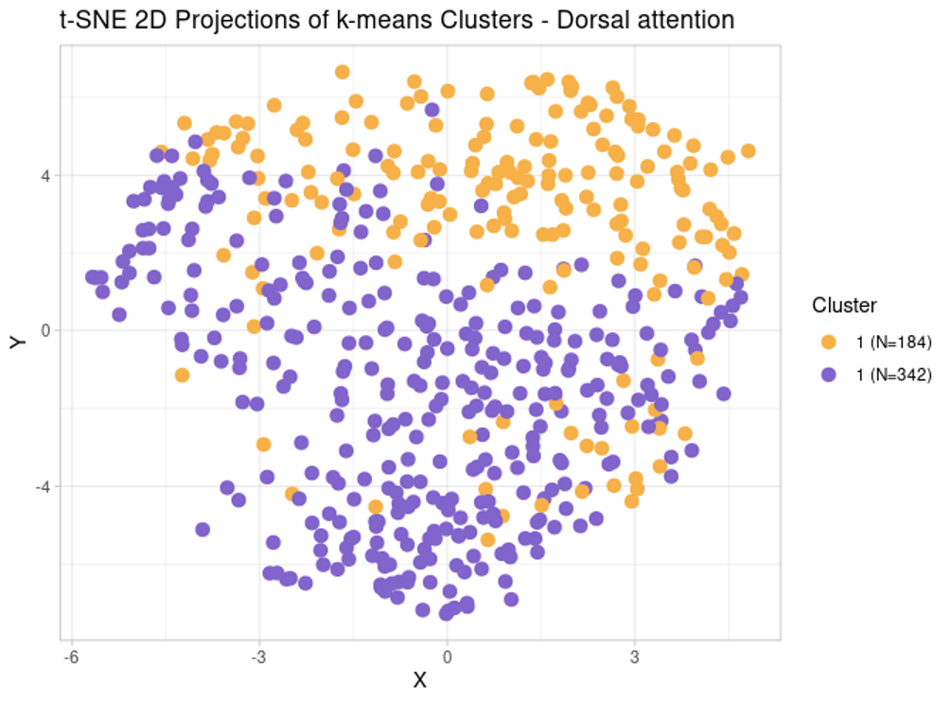
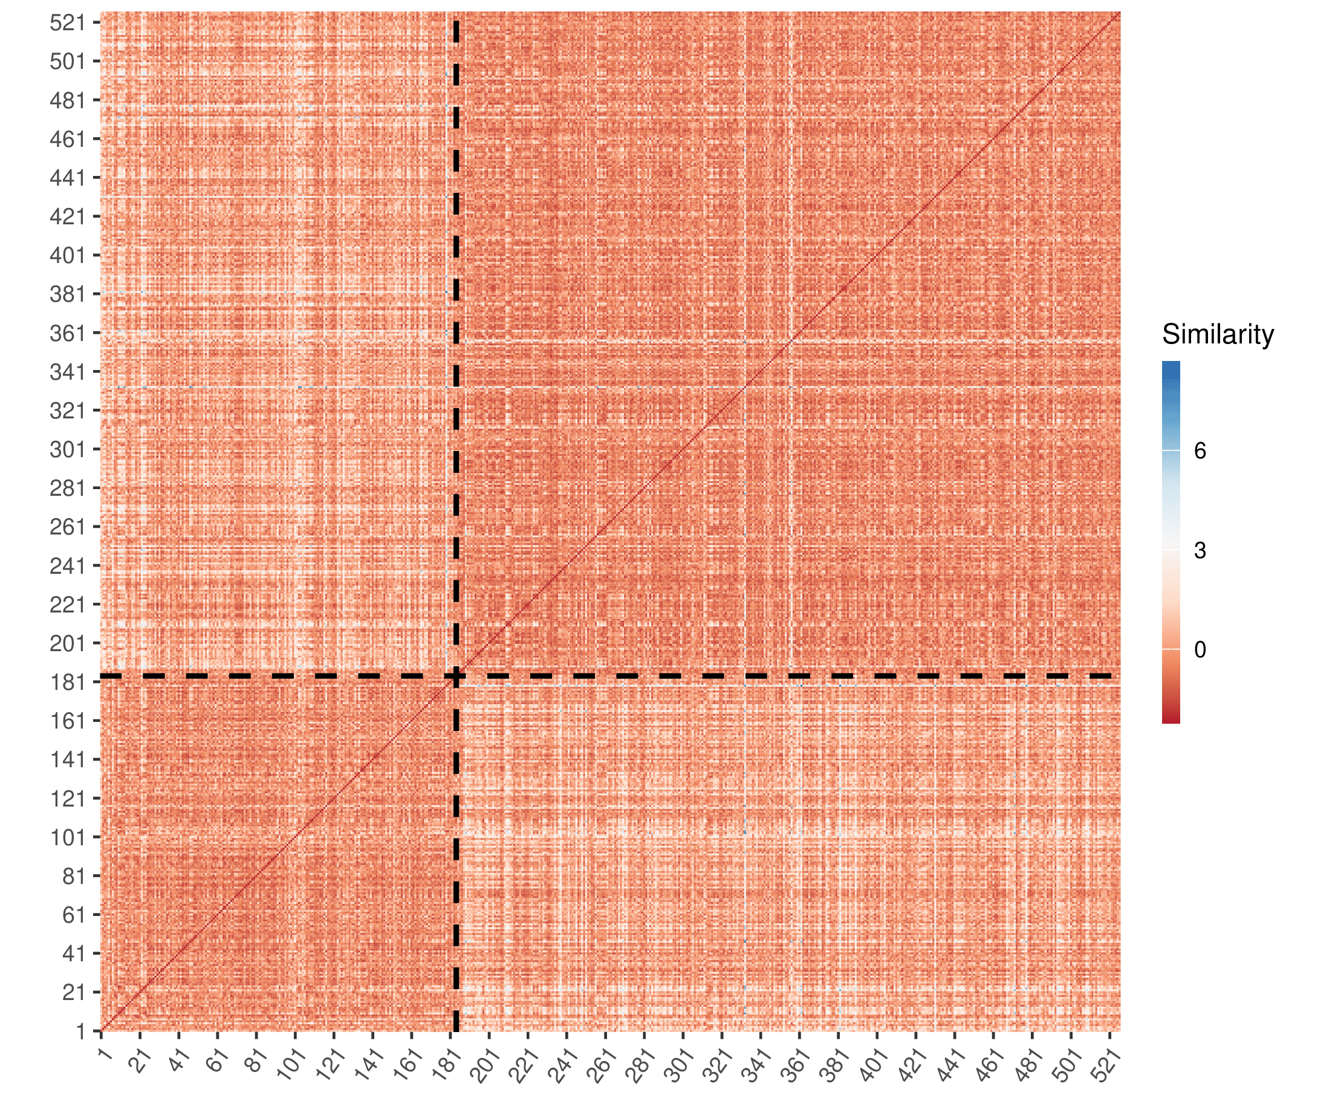
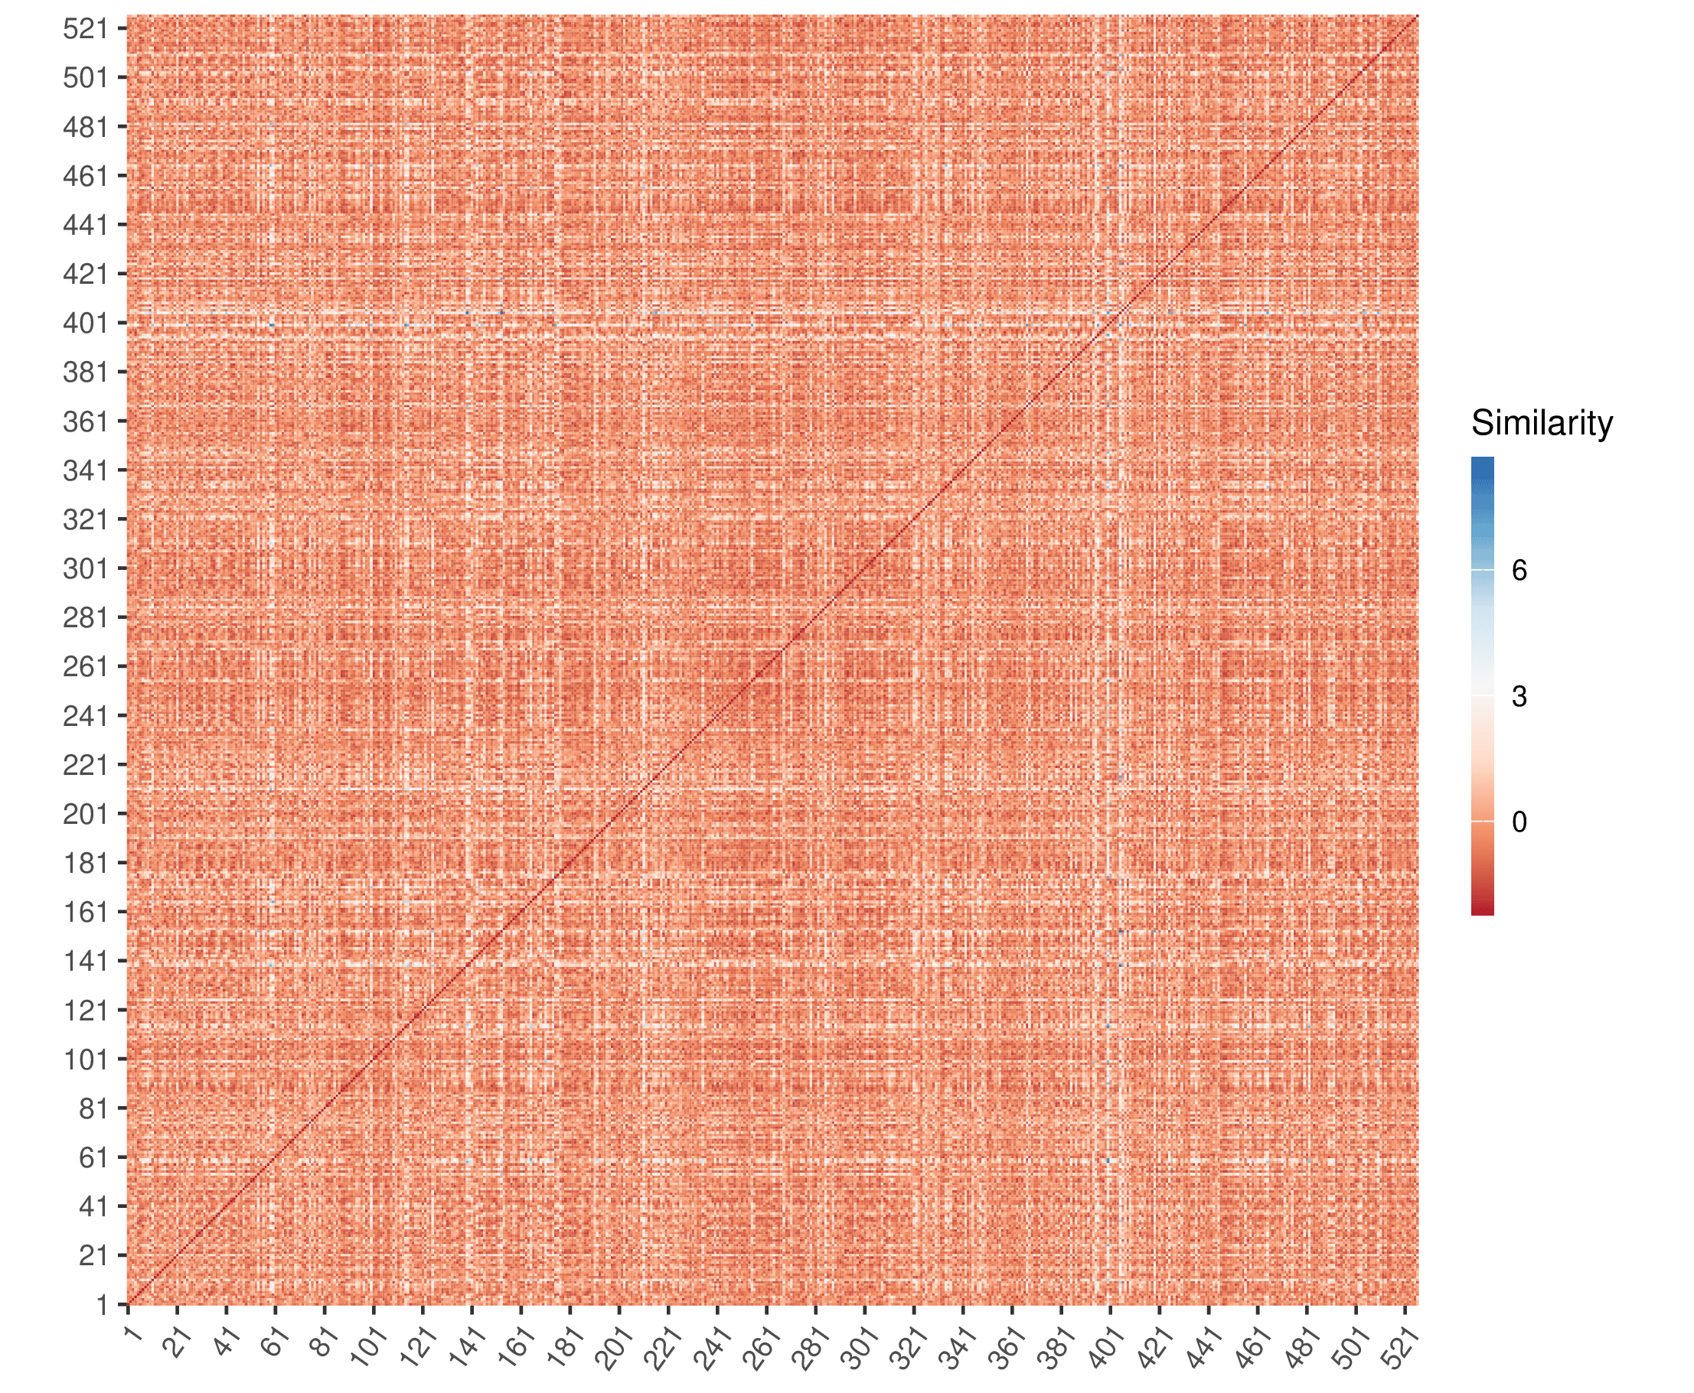
Dimensionality Reduction
24 phenotypic measures → 526 continuous time courses?
24 phenotypic measures → 2-4 “narrative comprehension profiles”
Similarity
Notes:
Mention dtw, measure how different they are

Slide 24
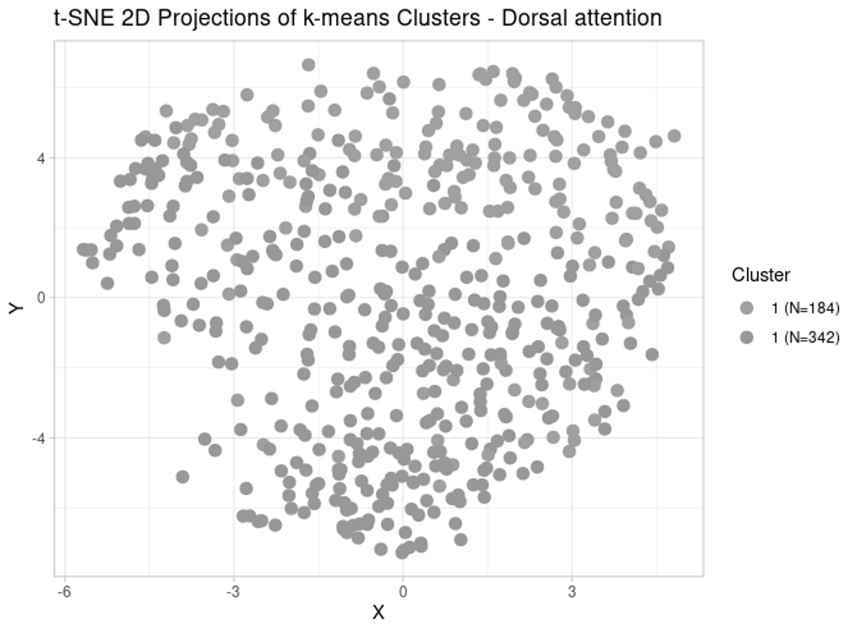
Dimensionality Reduction
24 phenotypic measures → 526 continuous time courses?
24 phenotypic measures → 2-4 “narrative comprehension profiles”
Similarity

Slide 25
k-medoids Clustering
medoid = median (actual data point) serves as cluster centroids
centroid = center of the cluster; the point from which distance to other data is measured
k = number of clusters
Sim.

Slide 26

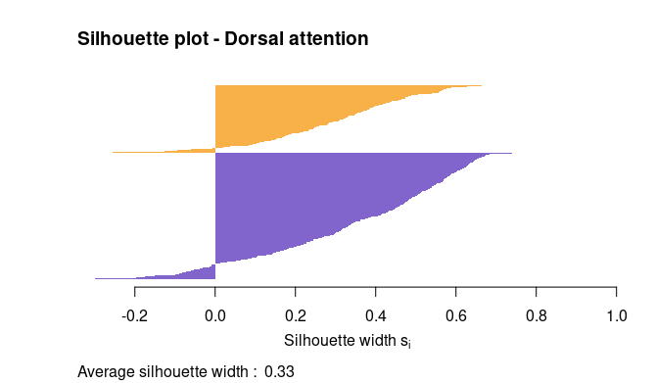
Clustering Results
Network | Optimal # Clusters | Average Sil. Width | Cluster Sizes
Dorsal attention | 2 | 0.33 | 184:342
Ventral attention | 2 | 0.34 | 262:264
Frontoparietal | 4 | 0.28 | 91:131:186:249
DMN | 3 | 0.32 | 149:152:225
ToM | 2 | 0.38 | 298:228
Notes:
A clustering with an average silhouette width of over 0.7 is considered to be "strong", a value over 0.5 "reasonable" and over 0.25 "weak", but with increasing dimensionality of the data, it becomes difficult to achieve such high values because of the curse of dimensionality, as the distances become more similar.
- Dimensions: # Ps = 526; # distances = 526; total = almost 300,000 comparisons in calculating cluster membership

Slide 27
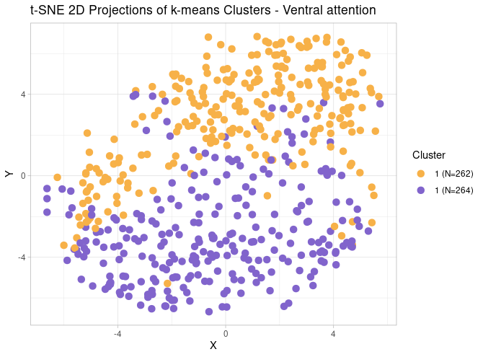
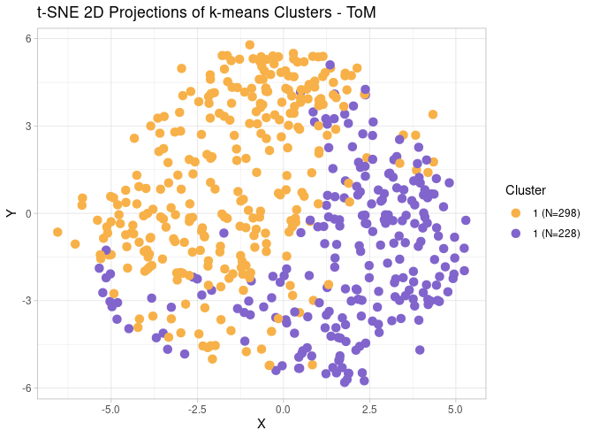
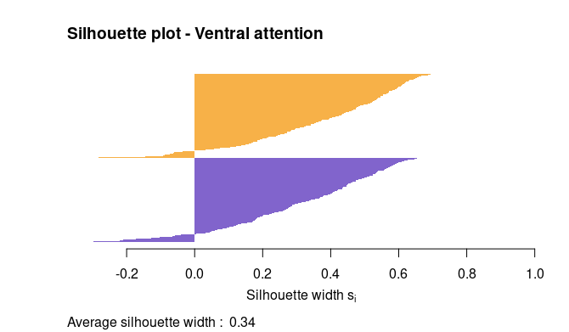
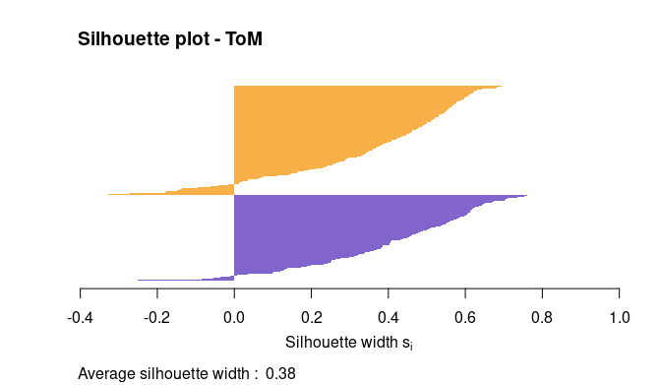

Slide 28
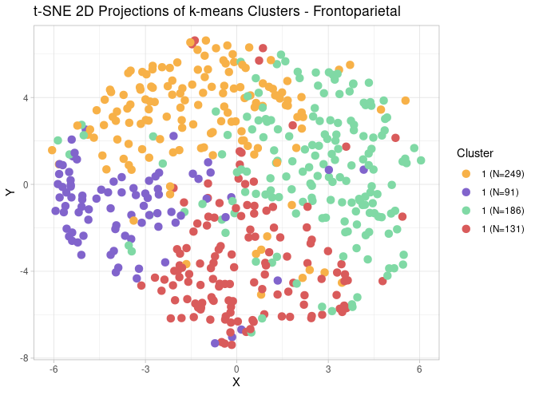
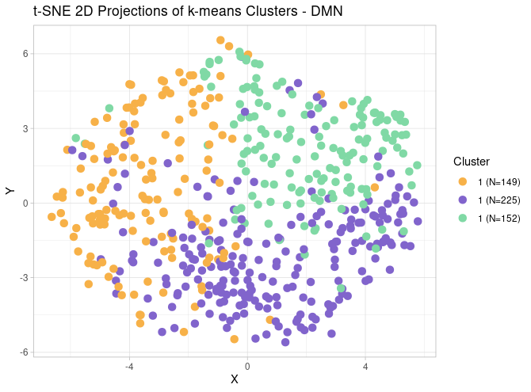
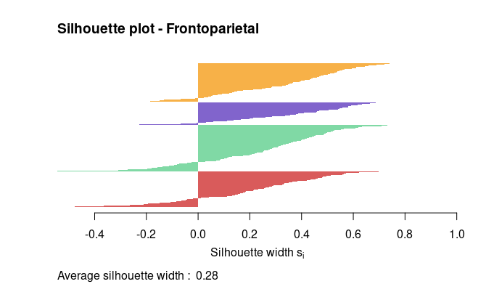
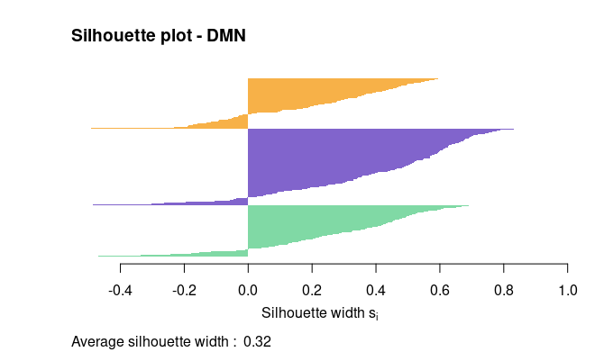
Notes:
STOP HERE?

Slide 29
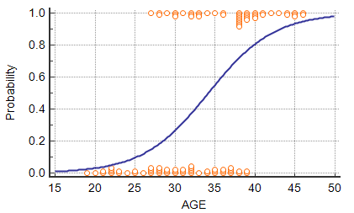
Predictive Modeling
24 phenotypic measures → 2-4 “narrative comprehension profiles”
Logistic Regression
Ridge regularization: shrinks all parameters
LASSO regularization: shrinks some variables to 0 (feature selection)
Notes:
Both prevent overfitting, good for high number of predictor
Probability = P of being in cluster 1

Slide 30
Model Construction
Input: phenotypic measures
Output: narrative comprehension profile
5 models * 8 networks
LASSO – all measures
Ridge – all measures
LASSO – composite measures
Ridge – composite measures
Ridge – LASSO selected measures
80/20 train/test split
Stratified by cluster
Optimized hyperparameter lambda: 10-fold cross-validation using training data
Result: classification model with minimized loss/error, coefficient values for variables

Slide 31
Model Performance
all = all measures
comp = composite measures
sel = lasso selected measures
2 Clusters
Network | Model | Sensitivity | Specificity | Precision | F1 score | Balanced Accuracy | Accuracy
Dorsal attn. | LASSO (all) | 0.57 | 0.39 | 0.33 | 0.42 | 0.48 | 0.45
Ventral attn. | Ridge (comp) | 0.58 | 0.51 | 0.54 | 0.56 | 0.55 | 0.55
ToM | Ridge (all) | 1 | 0 | 0.43 | 0.61 | 0.5 | 0.43
F1 > 0.9 = excellent
F1 = 0.5-0.8 = average
F1 < 0.5 = poor
Notes:
1/0 model completely correctly classified positive cases and misses all negative cases
Balanced Accuracy: average recall for each class ([TPR + TNR] / 2)

Slide 32
Model Performance
all = all measures
comp = composite measures
sel = lasso selected measures
3 Clusters
Network | Model | Cluster | Sensitivity | Specificity | Precision | F1 score | Balanced Accuracy | Accuracy
DMN | Ridge (sel) | 1 | 0.07 | 0.83 | 0.13 | 0.09 | 0.45 | 0.34
 |  | 2 | 0.64 | 0.26 | 0.39 | 0.49 | 0.45
 |  | 3 | 0.16 | 0.84 | 0.29 | 0.21 | 0.50
F1 > 0.9 = excellent
F1 = 0.5-0.8 = average
F1 < 0.5 = poor
Notes:
Balanced Accuracy: average recall for each class ([TPR + TNR] / 2)

Slide 33
Model Performance
all = all measures
comp = composite measures
sel = lasso selected measures
4 Clusters
Network | Model | Cluster | Sensitivity | Specificity | Precision | F1 score | Balanced Accuracy | Accuracy
Frontoparietal | Ridge (sel) | 1 | 0.98 | 0.09 | 0.42 | 0.59 | 0.54 | 0.42
 |  | 2 | 0.045 | 0.99 | 0.5 | 0.08 | 0.52
 |  | 3 | 0.09 | 0.96 | 0.4 | 0.14 | 0.53
 |  | 4 | 0 | 1 | NA | NA | 0.5
F1 > 0.9 = excellent
F1 = 0.5-0.8 = average
F1 < 0.5 = poor
Notes:
Trade-offs of over-fitting
Balanced Accuracy: average recall for each class ([TPR + TNR] / 2)

Slide 34
Future Directions
Improve models
Improve clustering?
Reduce over-fitting?
Try different algorithms? (e.g., SVM)
Obtain confidence intervals for model accuracy
Cross-validation, p-values
Explore different permutations of data
E.g., within-subject functional connectivity, leave-one-out ISC

Slide 35
Links (Part 2)
R code: pre-processing
R code: descriptive statistics
R code: clustering
R code: logistic regressions

Slide 36
Questions & Discussion
Notes:
Flaws? What would you do differently? What are you interested in exploring?
Issues with clustering; best I can achieve with smoothing; consider within-subject connectivity?
Ways to improve model accuracy?

